Slide 1
CS 152 Computer Architecture and Engineering CS252 Graduate Computer Architecture Lecture 13 –VLIW
Krste Asanovic
Electrical Engineering and Computer Sciences
University of California at Berkeley
http://www.eecs.berkeley.edu/~krste
http://inst.eecs.berkeley.edu/~cs152

Slide 2
Last Time in Lecture 12
Branch prediction
temporal, history of a single branch
spatial, based on path through multiple branches
Branch History Table (BHT) vs. Branch History Buffer (BTB)
tradeoff in capacity versus latency
Return-Address Stack (RAS)
specialized structure to predict subroutine return addresses
Advanced branch prediction structures
Perceptron
TAGE

Slide 3
Superscalar Control Logic Scaling
Issue Width W
Issue Group
Previously Issued Instructions
Lifetime L
Each issued instruction must somehow check against W*L instructions, i.e., growth in hardware ∝ W*(W*L)
For in-order machines, L is related to pipeline latencies and check is done during issue (interlocks or scoreboard)
For out-of-order machines, L also includes time spent in instruction buffers (instruction window or ROB), and check is done by broadcasting tags to waiting instructions at write back (completion)
As W increases, larger instruction window is needed to find enough parallelism to keep machine busy => greater L
=> Out-of-order control logic grows faster than W² (~W³)

Slide 4
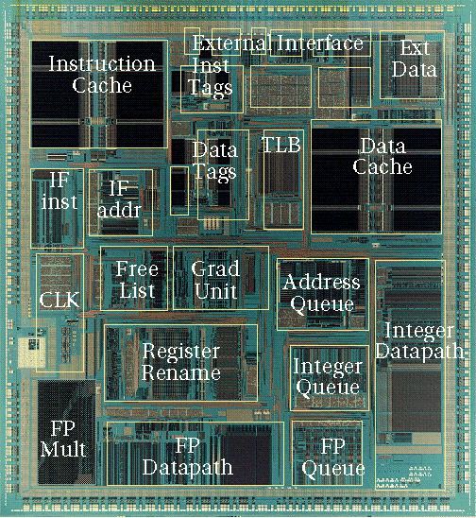
Out-of-Order Control Complexity: MIPS R10000
Control Logic
[ SGI/MIPS Technologies Inc., 1995 ]

Slide 5
Sequential ISA Bottleneck
Sequential source code
Superscalar compiler
Sequential machine code
a = foo(b);
for (i=0, i<
Find independent operations
Schedule operations
Superscalar processor
Check instruction dependencies
Schedule execution

Slide 6
VLIW: Very Long Instruction Word
Int Op 1
Int Op 2
Mem Op 1
Mem Op 2
FP Op 1
FP Op 2
Two Integer Units,
Single-Cycle Latency
Two Load/Store Units,
Three-Cycle Latency
Two Floating-Point Units,
Four-Cycle Latency
Multiple operations packed into one instruction
Each operation slot is for a fixed function
Constant operation latencies are specified
Architecture requires guarantee of:
Parallelism within an instruction => no cross-operation RAW check
No data use before data ready => no data interlocks

Slide 7
Early VLIW Machines
FPS AP120B (1976)
scientific attached array processor
first commercial wide instruction machine
hand-coded vector math libraries using software pipelining and loop unrolling
Multiflow Trace (1987)
commercialization of ideas from Fisher’s Yale group including “trace scheduling”
available in configurations with 7, 14, or 28 operations/instruction
28 operations packed into a 1024-bit instruction word
Cydrome Cydra-5 (1987)
7 operations encoded in 256-bit instruction word
rotating register file

Slide 8
VLIW Compiler Responsibilities
Schedule operations to maximize parallel execution
Guarantees intra-instruction parallelism
Schedule to avoid data hazards (no interlocks)
Typically separates operations with explicit NOPs

Slide 9
Loop Execution
for (i=0; i<N; i++)
B[i] = A[i] + C;
Int1
Int 2
M1
M2
FP+
FPx
loop:
add x1
fld
Compile
loop: fld f1, 0(x1)
add x1, 8
fadd f2, f0, f1
fsd f2, 0(x2)
add x2, 8
bne x1, x3, loop
fadd
Schedule
add x2
bne
fsd
How many FP ops/cycle?
1 fadd / 8 cycles = 0.125

Slide 10
Loop Unrolling
for (i=0; i<N; i++)
B[i] = A[i] + C;
Unroll inner loop to perform 4 iterations at once
for (i=0; i<N; i+=4)
{
B[i] = A[i] + C;
B[i+1] = A[i+1] + C;
B[i+2] = A[i+2] + C;
B[i+3] = A[i+3] + C;
}
Need to handle values of N that are not multiples of unrolling factor with final cleanup loop

Slide 11
Scheduling Loop Unrolled Code
Unroll 4 ways
loop: fld f1, 0(x1)
fld f2, 8(x1)
fld f3, 16(x1)
fld f4, 24(x1)
add x1, 32
fadd f5, f0, f1
fadd f6, f0, f2
fadd f7, f0, f3
fadd f8, f0, f4
fsd f5, 0(x2)
fsd f6, 8(x2)
fsd f7, 16(x2)
fsd f8, 24(x2)
add x2, 32
bne x1, x3, loop
Int1
Int 2
M1
M2
FP+
FPx
loop:
fld f1
fld f2
fld f3
add x1
fld f4
fadd f5
Schedule
fadd f6
fadd f7
fadd f8
fsd f5
fsd f6
fsd f7
add x2
bne
fsd f8
How many FLOPS/cycle?
4 fadds / 11 cycles = 0.36

Slide 12
Software Pipelining
Unroll 4 ways first
Int1
Int 2
M1
M2
FP+
FPx
loop: fld f1, 0(x1)
fld f2, 8(x1)
fld f3, 16(x1)
fld f4, 24(x1)
add x1, 32
fadd f5, f0, f1
fadd f6, f0, f2
fadd f7, f0, f3
fadd f8, f0, f4
fsd f5, 0(x2)
fsd f6, 8(x2)
fsd f7, 16(x2)
add x2, 32
fsd f8, -8(x2)
bne x1, x3, loop
fld f1
fld f2
fld f3
add x1
fld f4
prolog
fld f1
fadd f5
fld f2
fadd f6
fld f3
fadd f7
add x1
fld f4
fadd f8
loop:
fld f1
fsd f5
fadd f5
iterate
fld f2
fsd f6
fadd f6
add x2
fld f3
fsd f7
fadd f7
add x1
bne
fld f4
fsd f8
fadd f8
fsd f5
fadd f5
fsd f6
fadd f6
epilog
add x2
fsd f7
fadd f7
bne
fsd f8
fadd f8
How many FLOPS/cycle?
4 fadds / 4 cycles = 1
fsd f5

Slide 13
Software Pipelining vs. Loop Unrolling
Loop Unrolled
Wind-down overhead
performance
Startup overhead
time
Loop Iteration
Software Pipelined
performance
time
Loop Iteration
Software pipelining pays startup/wind-down costs only once per loop, not once per iteration

Slide 14
CS152 Administrivia
Lab 3 out today, due Monday April 5 (after spring break)
PS 3 due Monday March 15
Midterm regrade requests due in one week
Tuesday March 16 11:59PM

Slide 15
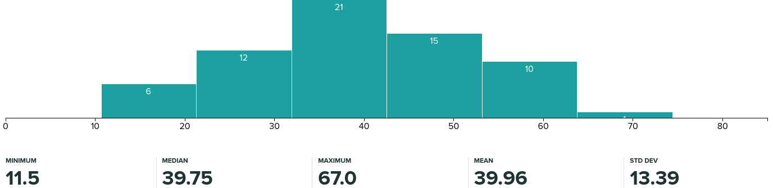
CS152 Midterm 1 Stats

Slide 16
CS252 Administrivia
Second half of project presentations this week
Readings next week on OoO superscalar microprocessors

Slide 17
What if there are no loops?
Branches limit basic block size in control-flow intensive irregular code
Difficult to find ILP in individual basic blocks
Basic block

Slide 18
Trace Scheduling [ Fisher,Ellis]
Pick string of basic blocks, a trace, that represents most frequent branch path
Use profiling feedback or compiler heuristics to find common branch paths
Schedule whole “trace” at once
Add fixup code to cope with branches jumping out of trace

Slide 19
Problems with “Classic” VLIW
Object-code compatibility
have to recompile all code for every machine, even for two machines in same generation
Object code size
instruction padding wastes instruction memory/cache
loop unrolling/software pipelining replicates code
Scheduling variable latency memory operations
caches and/or memory bank conflicts impose statically unpredictable variability
Knowing branch probabilities
Profiling requires an significant extra step in build process
Scheduling for statically unpredictable branches
optimal schedule varies with branch path

Slide 20
VLIW Instruction Encoding
Group 1
Group 2
Group 3
Schemes to reduce effect of unused fields
Compressed format in memory, expand on I-cache refill
used in Multiflow Trace
introduces instruction addressing challenge
Mark parallel groups
used in TMS320C6x DSPs, Intel IA-64
Provide a single-op VLIW instruction
Cydra-5 UniOp instructions

Slide 21
Intel Itanium, EPIC IA-64
EPIC is the style of architecture (cf. CISC, RISC)
Explicitly Parallel Instruction Computing (really just VLIW)
IA-64 is Intel’s chosen ISA (cf. x86, MIPS)
IA-64 = Intel Architecture 64-bit
An object-code-compatible VLIW
Merced was first Itanium implementation (cf. 8086)
First customer shipment expected 1997 (actually 2001)
McKinley, second implementation shipped in 2002
Recent version, Poulson, eight cores, 32nm, announced 2011

Slide 22
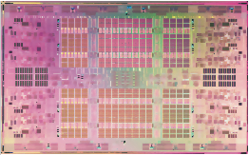
Eight Core Itanium “Poulson” [Intel 2011]
8 cores
1-cycle 16KB L1 I&D caches
9-cycle 512KB L2 I-cache
8-cycle 256KB L2 D-cache
32 MB shared L3 cache
544mm² in 32nm CMOS
Over 3 billion transistors
Cores are 2-way multithreaded
6 instruction/cycle fetch
Two 128-bit bundles
Up to 12 insts/cycle execute

Slide 23
IA-64 Instruction Format
Template bits describe grouping of these instructions with others in adjacent bundles
Each group contains instructions that can execute in parallel
Instruction 2
Instruction 1
Instruction 0
Template
128-bit instruction bundle
bundle j-1
bundle j
bundle j+1
bundle j+2
group i-1
group i
group i+1
group i+2

Slide 24
IA-64 Registers
128 General Purpose 64-bit Integer Registers
128 General Purpose 64/80-bit Floating Point Registers
64 1-bit Predicate Registers
GPRs “rotate” to reduce code size for software pipelined loops
Rotation is a simple form of register renaming allowing one instruction to address different physical registers on each iteration

Slide 25
Rotating Register Files
Problems: Scheduled loops require lots of registers, Lots of duplicated code in prolog, epilog
Solution: Allocate new set of registers for each loop iteration
25

Slide 26
Rotating Register File
P7
P6
RRB=3
P5
P4
P3
R1
+
P2
P1
P0
Rotating Register Base (RRB) register points to base of current register set. Value added on to logical register specifier to give physical register number. Usually, split into rotating and non-rotating registers.
26

Slide 27
Rotating Register File (Previous Loop Example)
Three cycle load latency encoded as difference of 3 in register specifier number (f4 - f1 = 3)
Four cycle fadd latency encoded as difference of 4 in register specifier number (f9 – f5 = 4)
ld f1, ()
fadd f5, f4, ...
sd f9, ()
bloop
ld P9, ()
fadd P13, P12,
sd P17, ()
bloop
RRB=8
ld P8, ()
fadd P12, P11,
sd P16, ()
bloop
RRB=7
ld P7, ()
fadd P11, P10,
sd P15, ()
bloop
RRB=6
ld P6, ()
fadd P10, P9,
sd P14, ()
bloop
RRB=5
ld P5, ()
fadd P9, P8,
sd P13, ()
bloop
RRB=4
ld P4, ()
fadd P8, P7,
sd P12, ()
bloop
RRB=3
ld P3, ()
fadd P7, P6,
sd P11, ()
bloop
RRB=2
ld P2, ()
fadd P6, P5,
sd P10, ()
bloop
RRB=1
27

Slide 28
IA-64 Predicated Execution
Problem: Mispredicted branches limit ILP
Solution: Eliminate hard to predict branches with predicated execution
Almost all IA-64 instructions can be executed conditionally under predicate
Instruction becomes NOP if predicate register false
b0:
Inst 1
Inst 2
br a==b, b2
if
Inst 1
Inst 2
p1,p2 <- cmp(a==b)
(p1) Inst 3 || (p2) Inst 5
(p1) Inst 4 || (p2) Inst 6
Inst 7
Inst 8
b1:
Inst 3
Inst 4
br b3
else
Predication
b2:
Inst 5
Inst 6
then
One basic block
b3:
Inst 7
Inst 8
Mahlke et al, ISCA95: On average >50% branches removed
Four basic blocks
Warning: Complicates bypassing!

Slide 29
IA-64 Speculative Execution
Problem: Branches restrict compiler code motion
Solution: Speculative operations that don’t cause exceptions
Load.s r1
Inst 1
Inst 2
br a==b, b2
Speculative load never causes exception, but sets “poison” bit on destination register
Inst 1
Inst 2
br a==b, b2
Load r1
Use r1
Inst 3
Check for exception in original home block jumps to fixup code if exception detected
Chk.s r1
Use r1
Inst 3
Can’t move load above branch because might cause spurious exception
Particularly useful for scheduling long latency loads early

Slide 30
IA-64 Data Speculation
Problem: Possible memory hazards limit code scheduling
Solution: Hardware to check pointer hazards
Data speculative load adds address to address check table
Inst 1
Inst 2
Store
Load.a r1
Inst 1
Inst 2
Store
Store invalidates any matching loads in address check table
Load r1
Use r1
Inst 3
Load.c
Use r1
Inst 3
Can’t move load above store because store might be to same address
Check if load invalid (or missing), jump to fixup code if so
Requires associative hardware in address check table

Slide 31
Limits of Static Scheduling
Statically unpredictable branches
Variable memory latency (unpredictable cache misses)
Code size explosion
Compiler complexity
Despite several attempts, VLIW has failed in general-purpose computing arena (so far).
More complex VLIW architectures are close to in-order superscalar in complexity, no real advantage on large complex apps.
Successful in embedded DSP market
Simpler VLIWs with more constrained environment, friendlier code.

Slide 32
Intel Kills Itanium
Donald Knuth “ … Itanium approach that was supposed to be so terrific—until it turned out that the wished-for compilers were basically impossible to write.”
“Intel officially announced the end of life and product discontinuance of the Itanium CPU family on January 30th, 2019”, Wikipedia

Slide 33
Acknowledgements
This course is partly inspired by previous MIT 6.823 and Berkeley CS252 computer architecture courses created by my collaborators and colleagues:
Arvind (MIT)
Joel Emer (Intel/MIT)
James Hoe (CMU)
John Kubiatowicz (UCB)
David Patterson (UCB)

